Slide 1
Music Player
CISC213.N81

Slide 2
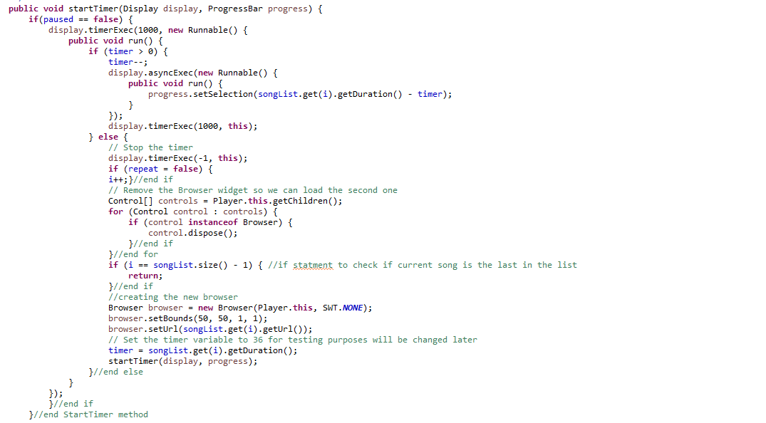
Nicholas Ciccotto
Got the music player to play music, created ability to skip, pause, repeat, and skip around songs
Created the timer method that enables songs to play continuously

Slide 3
Dominik Tyrk
Got The Json file, format, and parser up and running to create song objects and list of songs
Got the playlist and playlistCollections clasess up and running so we can have the ability to store songs in the playlists via create playlist button and then be able to keep the playlists stored in the playlistCollections object to be able for a user to store multiple playlists.
Got the genre tree working utilizing a hashmap that searched through the genres and map the genres as keys to the songs as values
Worked on the queue to be able to play each song object inside of a playlist
Worked on the shuffle feature that allowed the user to randomize their playlists
Stored songs into the json file

Slide 4
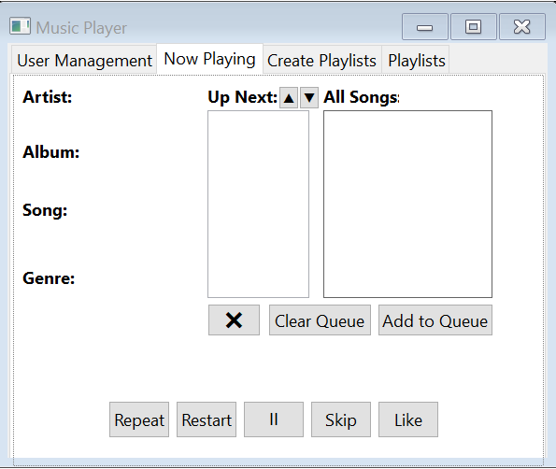
Brian Nguyen
Helped Create the design for the now playing tab of the GUI
Created the system playlist. Genre, Liked, Year
Helped out with the song and songs class by splitting up the different methods

Slide 5
Quinn Meskers
Figured out the github, got it working and managed the repository
Implemented the merges and resolved the conflicts or issues with them
Some larger issues were:
The player at the time was entirely using a shell and we needed more room, so we implemented tabs and ran into an issue with the tabs not showing up.
The issue ended up being caused by the classpaths.
ran into an issue with the genre tree that was opening another browser when you selected a song rather than opening the song in the current browser.
Changed the code to grab the song selected by using the index.

Slide 6
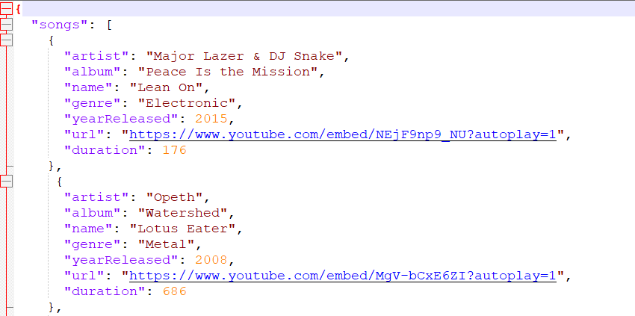
Timur Akhunbaev
Search Button
Clear Queue Button
Worked on fixing the bugs
Created song objects in the json file
Tested songs

Slide 7
Nick Tagliamonte
Tabs:
I added the initial tabs and the early versions of the buttons on the playlist and playlist creation tabs
Addressed tab/shell integration bug
User Management/User Playlists:
Added the IO methods and files in the playlistcollections and userIO classes
Login/sign out
Like system:
I added the like button to the now playing tab which allows a user to add a song to their “liked songs” playlist
file i/o functionality was introduced and tested so that the liked song is available on later sign ins

